Slide 1
Effect of finerenone on chronic kidney disease outcomes in type 2 diabetes
Rajiv Agarwal
on behalf of G.L. Bakris, R. Agarwal, S.D. Anker, B. Pitt, L.M. Ruilope, P. Rossing, P. Kolkhof, C. Nowack, P. Schloemer, A. Joseph, G. Filippatos, and the
FIDELIO-DKD international investigator team
23 October 2020
MA-M_FIN-ALL-0145-1

Slide 2

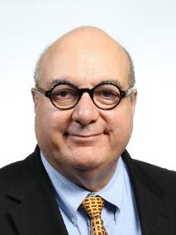
Presenter disclosures
Rajiv Agarwal
Personal fees and/or non-financial support from:
Research funding, paid to University of Chicago from:
Personal fees from:
Bayer Heathcare Pharmaceuticals Inc.
Akebia Therapeutics
Janssen
Relypsa
Vifor Pharma
Boehringer Ingelheim
Sanofi
Eli Lilly
AstraZeneca
Fresenius
Ironwood Pharmaceuticals
Merck & Co.
Lexicon
Reata
Otsuka America Pharmaceuticals
Opko Pharmaceuticals
E. R. Squibb & Sons
George Bakris
Bayer Heathcare
NovoNordisk
Vascular Dynamics
Merck
Relypsa
Alnylam

Slide 3

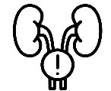
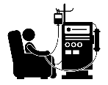

Global burden of kidney failure – diabetes is the leading cause
7600 million – global population
844 million – global prevalence of CKD
3.9 million – patients on KRT
As many might die due to lack of KRT

Slide 4

FIDELIO-DKD rationale
High residual risk of CKD progression with current therapies
RENAAL³
Composite primary endpoint*
Hemodynamic^{1,2}
(elevated blood pressure and/or intraglomerular pressure)
60
RR=16%; p=0.02
50
Placebo
40
Losartan
30
Patients with an event (%)
20
10
Residual risk
0
0
12
24
36
48
Months of study

Slide 5

FIDELIO-DKD rationale
High residual risk of CKD progression with current therapies
CREDENCE³
Cardiorenal composite endpoint*
Hemodynamic^{1,2}
(elevated blood pressure and/or intraglomerular pressure)
25
HR=0.70 (95% CI 0.59–0.82); p=0.00001
20
Placebo + ACEi/ARB
Canagliflozin + ACEi/ARB
Metabolic^{1,2}
(poor glycemic control)
15
Patients with an event (%)
10
5
Residual risk
Residual risk
0
0
6
12
18
24
30
36
42
Months since randomization

Slide 6


FIDELIO-DKD rationale
High residual risk of CKD progression with current therapies
Hemodynamic^{1,2}
(elevated blood pressure and/or intraglomerular pressure)
Inflammation
and fibrosis^{1–3}
Metabolic^{1,2}
(poor glycemic control)
Not specifically targeted by existing treatments^{1,4}

Slide 7
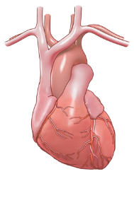
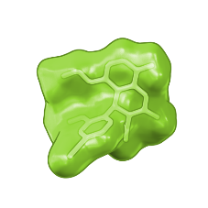
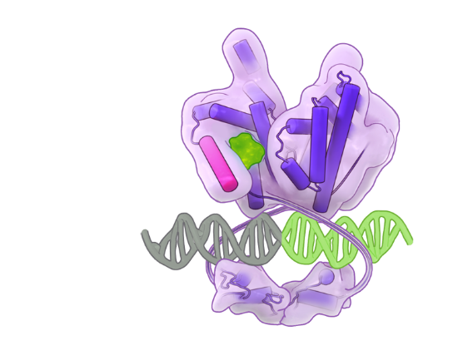
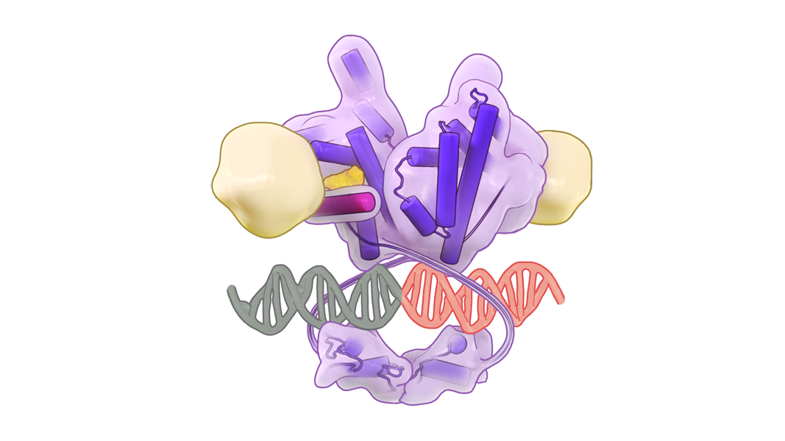
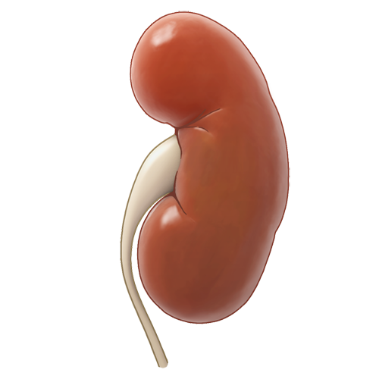


FIDELIO-DKD rationale
Finerenone
MR
Finerenone is a novel, selective, non-steroidal MRA that inhibits inflammation and fibrosis and protects against progressive kidney and CV dysfunction in preclinical models¹
Inflammation
and fibrosis
Inhibition of
Inflammation and fibrosis
ARTS-DN (patients with CKD and T2D)
– finerenone improved albuminuria independent of measured changes in BP²
DNA
Hypothesis: MR antagonism with finerenone slows CKD progression and
reduces CV morbidity and mortality in patients with advanced CKD and T2D³

Slide 8



FIDELIO-DKD eligibility criteria
Key inclusion criteria
Key exclusion criteria
Aged ≥18 years with CKD and T2D
Pretreated with optimized therapy, including an ACEi or ARB at a max tolerated dose for ≥4 weeks
Serum potassium ≤4.8 mmol/L
Diabetic retinopathy for patients with A2 albuminuria
Non-diabetic kidney disease, including
clinically relevant renal artery stenosis
HFrEF with NYHA class II–IV
HbA1c >12%
Uncontrolled arterial hypertension*
Albuminuria categories (mg albumin/g creatinine)
A1 Normal to mildly elevated | A2 Moderately elevated | A3 Severely elevated
0–29 | 30–299 | ≥300–4999
GFR categories (mL/min/1.73 m²) | G1 | >90
 | G2 | 60–89
 | G3a | 45–59
 | G3b | 30–44
 | G4 | 15–29
 | G5 | <15

Slide 9


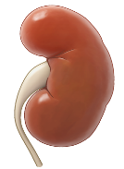
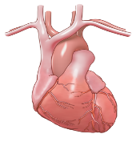


FIDELIO-DKD study design
13,911 patients enrolled
5734 patients randomized
2.6 years’ median follow-up
R
Finerenone 10 or 20 mg od*
Post-treatment
follow-up
Run-in (4–16 weeks)
Screening
Placebo
Post-treatment
follow-up
Hierarchical endpoints
Kidney composite
CV composite
3.
Death from any cause
Time to kidney failure, sustained ≥40% decrease in eGFR from baseline, or
renal death
Time to CV death,
non-fatal MI,
non-fatal stroke
or hospitalization
for HF
4.
Hospitalization for
any cause
5.
Change in UACR
6.
Second kidney composite

Slide 10
Patients were randomized from 48 countries worldwide
Europe (n=2358; 41.6%)
North America
(n=944; 16.6%)
Asia (n=1579, 27.8%)
Oceania
(n=101, 1.8%)
Latin America
(n=593; 10.5%)
Africa
(n=99, 1.7%)
5734 patients randomized – 5674 patients in FAS –
99.7% completed the study

Slide 11
Baseline demographics and medications
 | Finerenone (n=2833) | Placebo (n=2841)
Mean age, years | 65 | 66
Male, % | 69% | 71%
Mean duration of T2D, years | 16.6 | 16.6
Mean HbA1c, % | 7.7 | 7.7
Blood pressure, mmHg | 138/76 | 138/76
Mean serum [K⁺], mmol/L | 4.4 | 4.4
ACEis, % | 34 | 35
ARBs, % | 66 | 65
Glucose-lowering therapies, % Insulin and analogs GLP-1RAs SGLT-2is | 97 65 7 4 | 98 63 7 5

Slide 12
Baseline kidney labs – balanced between treatment groups
eGFR (mL/min/1.73 m²)
UACR (mg/g)
UACR
30–<300
12.1%
eGFR ≥60
11.6%
eGFR <45
54.9%
eGFR 45–<60
33.5%
UACR ≥300
87.5%
Mean eGFR 44
Median UACR ~850
0.4% of patients had a UACR <30 mg/g

Slide 13
Albuminuria (UACR) change over time
(–4.7%)
(–3.0%)
(–2.0%)
(4.1%)
Placebo
Finerenone
LS mean ratio to baseline
(–34.7%)
(–41.3%)
(–39.9%)
(–29.3%)
LS mean ratio: 0.69 (0.66–0.71)*
Months since randomization
31% reduction in UACR at month 4 with finerenone vs placebo

Slide 14
Blood pressure and blood glucose
Max delta -3.2 at month 4 vs
+0.7 with placebo
Change in SBP (mmHg) over time
Placebo
Finerenone
Mean SBP
Change in HbA1c (%) over time
Mean HbA1c
Months since randomization

Slide 15
Primary endpoint
Kidney failure*, sustained ≥40% decrease in eGFR from baseline, or renal death
40
HR=0.82 (95% CI 0.73–0.93)
Placebo (600/2841)
p=0.
0
0
1
4
30
Finerenone (504/2833)
20
Cumulative incidence (%)
10
0
0
6
12
18
24
30
36
42
48
Time to first event (months)
No. at risk
Placebo
2841
2586
1758
792
82
Finerenone
2833
2607
1808
787
83

Slide 16
Components of the primary kidney-specific composite endpoint
Endpoint | Finerenone (n=2833) | Placebo (n=2841) | Hazard ratio (95% CI) |  | p- value
 | n (%) | n (%)
Primary composite kidney endpoint | 504 (17.8) | 600 (21.1) |  | 0.82 (0.73–0.93) | 0.0014
Kidney failure | 208 (7.3) | 235 (8.3) |  | 0.87 (0.72–1.05) | –
End-stage kidney disease | 119 (4.2) | 139 (4.9) |  | 0.86 (0.67–1.10) | –
Sustained eGFR <15 mL/min/1.73 m² | 167 (5.9) | 199 (7.0) |  | 0.82 (0.67–1.01) | –
Sustained ≥40% decrease in eGFR from baseline | 479 (16.9) | 577 (20.3) |  | 0.81 (0.72–0.92) | –
Renal death | 2 (<0.1) | 2 (<0.1) |  | – | –
Favors finerenone
Favors placebo

Slide 17
Key secondary endpoint
CV death, non-fatal MI, non-fatal stroke, or hospitalization for HF
25
HR=0.86 (95% CI 0.75–0.99)
Placebo (420/2841)
20
p=0.0339
Finerenone (367/2833)
15
Cumulative incidence (%)
10
5
0
0
6
12
18
24
30
36
42
48
Time to first event (months)
No. at risk
Placebo
2841
2653
1969
951
115
Finerenone
2833
2688
2017
984
111

Slide 18
Hierarchical endpoint analysis
 | Endpoint | Finerenone (n=2833) | Placebo (n=2841) | Hazard ratio (95% CI) |  | p-value
 |  | n (%) | n (%)
1
Primary kidney
504 (17.8)
600 (21.1)
0.82
composite endpoint
(0.73
0.0014
–
0.93)
2
Key secondary CV
367 (13.0)
420 (14.8)
0.86
composite endpoint
(0.75
0.0339
–
0.99)
3
Death from any
219 (7.7)
244 (8.6)
0.90
cause
(0.75
0.2348
–
1.07)
4
Hospitalization from
1263 (44.6)
1321 (46.5)
0.95
any cause
(0.88
–
–
1.02)
5
Change in UACR*
–
–
0.69
(0.66
–
–
0.71)*
6
Secondary composite
252 (8.9)
326 (11.5)
0.76
kidney endpoint#
(0.65
–
–
0.90)
Favours
finerenone
Favours
placebo
18

Slide 19
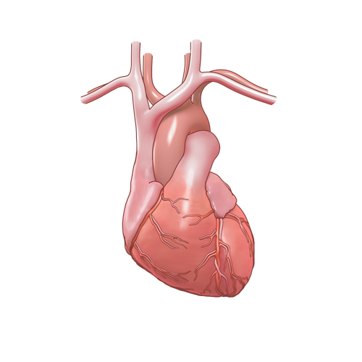
Efficacy summary
NNT for primary and key secondary endpoints over 3 years
Modest effects on blood pressure
Consistent effects on components of primary endpoint
Consistent effects across key subgroups, including eGFR and UACR at baseline
Primary
kidney endpoint
NNT=29
(95% CI 16–166)
Secondary
CV endpoint
NNT=42
(95% CI 22–397)

Slide 20
Investigator-reported treatment-emergent adverse events
Safety outcome, n (%) | Finerenone (n=2827) |  | Placebo (n=2831)
Any AE | 2468 | (87.3) | 2478 | (87.5)
AE related to study drug | 646 | (22.9) | 449 | (15.9)
AE leading to treatment discontinuation | 207 | (7.3) | 168 | (5.9)
Any serious AE | 902 | (31.9) | 971 | (34.3)
Serious AE related to study drug | 48 | (1.7) | 34 | (1.2)
Serious AE leading to treatment discontinuation | 75 | (2.7) | 78 | (2.8)
Most common AEs leading to treatment discontinuation
Hyperkalemia | 51 | (1.8) | 19 | (0.7)
Blood potassium increased | 13 | (0.5) | 6 | (0.2)

Slide 21
Change in serum potassium over time
(0.25)
(0.24)
(0.21)
(0.21)
(0.20)
Mean serum [K⁺] at baseline:
Finerenone: 4.4±0.5
Placebo: 4.4±0.5
Mean serum [K⁺] (mmol/L)
(0.02)
(0.04)
(0.05)
(0.07)
(0.07)
Months since randomization
Maximum mean difference in serum potassium between groups
= 0.23 mmol/L at month 4

Slide 22
Investigator-reported treatment-emergent adverse events related to hyperkalemia
Any treatment-emergent AE
Treatment-emergent AE
with clinical consequences
Finerenone (n=2827)
Placebo (n=2831)
Investigator-reported AEs relating to hyperkalemia*

Slide 23
Investigator-reported treatment-emergent adverse events related to acute kidney injury
Any treatment-emergent AE
Treatment-emergent AE
with clinical consequences
Finerenone (n=2827)
Placebo (n=2831)
Investigator-reported AEs relating to acute kidney injury

Slide 24
Safety summary
In a patient population with advanced CKD on maximally tolerated dose of ACEi/ARB, and excepting temporary withdrawal of study drug, K⁺ management was at the investigator’s discretion:
Finerenone was well tolerated
Overall treatment-emergent adverse events were similar between groups
Finerenone led to a mean increase in serum [K⁺] of 0.2 mmol/L across subpopulations vs placebo
Although hyperkalemia increased, it was manageable; only 2.3% of patients discontinued finerenone vs 0.9% on placebo

Slide 25

Benefit–risk in studies investigating RAS inhibition in similar patient populations
ALTITUDE¹
(CKD + T2D)
VA NEPHRON-D²
(CKD + T2D)
Lack of efficacy
Lack of efficacy
Kidney and CV efficacy
Permanent discontinuation
due to hyperkalemia (%)*
9.9%
4.8%
4.4%
2.6%
2.3%
0.9%
Median 2.7 years
Median 2.2 years
Median 2.6 years

Slide 26
Benefit–risk in studies investigating RAAS inhibition in similar patient populations
AMBER¹
(CKD)
Efficacy not studied
(Phase II)
Kidney and CV efficacy
Permanent discontinuation
due to hyperkalemia (%)*
23.0%
6.8%
2.3%
0.9%
12 weeks
Median 2.6 years

Slide 27
Overall summary and conclusions
In patients with CKD and T2D treated with optimized RAS therapy, finerenone was well-tolerated and significantly reduced:
  The risk of CKD progression by 18%
  The risk of CV morbidity and mortality by 14%

Slide 28

Thank you
48 countries, 1024 sites, 13,911* participants
Executive committee
George L. Bakris; Gerasimos Filippatos; Rajiv Agarwal; Stefan D. Anker; Luis M. Ruilope; Bertram Pitt
Independent data monitoring committee
Murray Epstein; Aldo Maggioni; Glenn Chertow; Gerald DiBona; Tim Friede; Jose Lopez-Sendon; Jean Rouleau
Clinical event committee
Rajiv Agarwal; Stefan Anker; Phyllis August; Andrew Coats; Hans Diener; Wolfram Döhner; Barry Greenberg;
Stephan von Haehling; James Januzzi; Alan Jardine; Carlos Kase; Sankar Navaneethan; Lauren Phillips;
Piotr Ponikowski; Pantelis Sarafidis; Titte Srinivas; Turgut Tatlisumak; John Teerlink
National lead investigators
Augusto Vallejos; Richard MacIsaac; Guntram Schernthaner; Pieter Gillard; Maria Eugenia F. Canziani; Theodora Temelkova-Kurktschiev; Ellen Burgess; Sheldon Tobe; Fernando González; Zhi-Hong Liu; Andrés Ángelo’ Cadena Bonfanti; Carlos Francisco Jaramillo; Martin Prazny; Peter Rossing; Jorma Strand; Michel Marre; Roland Schmieder; Christoph Wanner; Pantelis Sarafidis; Juliana Chan; László Rosivall; Joseph Eustace; Ehud Grossman; Yoram Yagil; Giuseppe Remuzzi; Daisuke Koya; Takashi Wada; Magdalena Madero Rovalo; Ron Gansevoort; Adriaan Kooy; Trine Finnes; Froilan De Leon; Janusz Gumprecht; Fernando Teixeira e Costa; Alexander Dreval; Anantharaman Vathsala; Aslam Amod; Sin Gon Kim; Byung Wan Lee; Julio Pascual Santos; Bengt-Olov Tengmark; Michel Burnier; Chien-Te Lee; SukitYamwong; Ramazan Sari; Kieran McCafferty; Borys Mankovsky; Sharon Adler; Linda Fried; Robert Toto; Mark Williams;Tran Quang Khan
The FIDELIO-DKD team would also like to thank all participating investigators, the centers, the patients and their families

